Slide 1
Introduction to OOP
Inheritance in Python

Slide 2
Inheritance in Python
Inheritance is a fundamental concept in object-oriented programming (OOP) that allows a class (called a child or derived class) to inherit attributes and methods from another class (called a parent or base class).
Here, a parent class Animal is created that has a method info(). Then a child classes Dog is created that inherit from Animal and add their own behavior.

Slide 3
Inheritance in Python
class Animal:
def __init__(self, name):
self.name = name
def info(self):
print("Animal name:", self.name)
class Dog(Animal):
def sound(self):
print(self.name, "barks")
d = Dog("Buddy")
# Inherited method
d.info()
d.sound()
Output
Animal name: Buddy
Buddy barks
Explanation:
class Animal defines the parent class.
info() prints the name of the animal.
class Dog(Animal) defines Dog as a child of Animal class.
d.info() calls parent method info() and d.sound() calls child method.

Slide 4
Why do we need Inheritance
  Promotes code reusability by sharing attributes and methods across classes.
  Models real-world hierarchies like Animal -> Dog or Person -> Employee.
  Simplifies maintenance through centralized updates in parent classes.
  Enables method overriding for customized subclass behavior.
  Supports scalable, extensible design using polymorphism.

Slide 5
super() Function
super() function is used to call methods from a superclass following Python’s Method Resolution Order (MRO). In particular, it is commonly used in the child class's __init__() method to initialize inherited attributes. This way, the child class can leverage the functionality of the parent class.
Example: Here, Dog uses super() to call Animal's constructor

Slide 6
super() Function
# Parent Class: Animal
class Animal:
def __init__(self, name):
self.name = name
def info(self):
print("Animal name:", self.name)
# Child Class: Dog
class Dog(Animal):
def __init__(self, name, breed):
# Calls constructor based on MRO
super().__init__(name)
self.breed = breed
def details(self):
print(self.name, "is a", self.breed)
d = Dog("Buddy", "Golden Retriever")
d.info() # Parent method
d.details() # Child method
Output
Animal name: Buddy
Buddy is a Golden Retriever
Explanation:
super() function is used inside __init__() method of Dog to call the constructor of Animal and initialize inherited attribute (name).
This ensures that parent class functionality is reused without needing to rewrite the code in the child class.

Slide 7
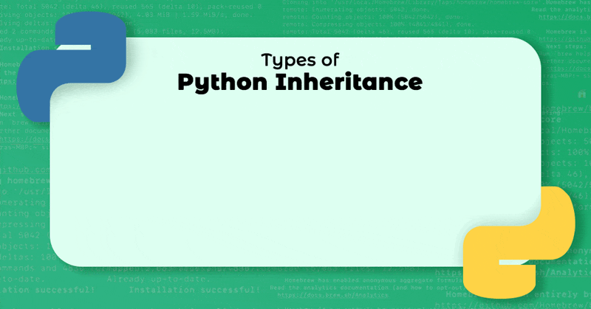
Types of Inheritance in Python
Inheritance is a key concept in object-oriented programming that allows one class (child/derived) to inherit the properties and methods of another class (parent/base). This promotes code reusability and improves maintainability. Here we a going to see the types of inheritance in Python.

Slide 8
Single Inheritance
Single inheritance enables a derived class to inherit properties from a single parent class, thus enabling code reusability and the addition of new features to existing code.

Slide 9
Single Inheritance
# Base class
class Parent:
def func1(self):
print("This function is in parent class.")
# Derived class
class Child(Parent):
def func2(self):
print("This function is in child class.")
# Driver code
obj = Child()
obj.func1()
obj.func2()
Output
This function is in parent class.
This function is in child class.
Explanation:
The Child class inherits the method func1() from Parent.
It also has its own method func2().
This shows how one class can extend another using single inheritance.

Slide 10
Multiple Inheritance
When a class can be derived from more than one base class this type of inheritance is called multiple inheritances. In multiple inheritances, all the features of the base classes are inherited into the derived class.

Slide 11
Multiple Inheritance
# Base class 1
class Mother:
mothername = ""
def mother(self):
print(self.mothername)
# Base class 2
class Father:
fathername = ""
def father(self):
print(self.fathername)
# Derived class
class Son(Mother, Father):
def parents(self):
print("Father :", self.fathername)
print("Mother :", self.mothername)
# Driver code
s1 = Son()
s1.fathername = “Ahmed"
s1.mothername = “Noreen"
s1.parents()

Slide 12
Multiple Inheritance
Output
Father : Ahmed
Mother : Noreen
Explanation:
Son inherits from both Mother and Father.
It can access both mothername and fathername.
This demonstrates how a class can combine functionalities from multiple sources.

Slide 13
Multilevel Inheritance
In multilevel inheritance, features of the base class and the derived class are further inherited into the new derived class. This is similar to a relationship representing a child and a grandfather.

Slide 14
Multilevel Inheritance
# Base class
class Grandfather:
def __init__(self, grandfathername):
self.grandfathername = grandfathername
# Intermediate class
class Father(Grandfather):
def __init__(self, fathername, grandfathername):
self.fathername = fathername
# Call the constructor of Grandfather
Grandfather.__init__(self, grandfathername)
# Derived class
class Son(Father):
def __init__(self, sonname, fathername, grandfathername):
self.sonname = sonname
# Call the constructor of Father
Father.__init__(self, fathername, grandfathername)
def print_name(self):
print('Grandfather name :', self.grandfathername)
print('Father name :', self.fathername)
print('Son name :', self.sonname)
# Driver code
s1 = Son(‘Ali', ‘Ahmed', ‘Farooq')
print(s1.grandfathername)
s1.print_name()

Slide 15
Multilevel Inheritance
Output
Grandfather name : Farooq
Father name : Ahmed
Son name : Ali
Explanation:
Son inherits from Father, and Father inherits from Grandfather.
Each constructor passes values up the inheritance chain using explicit constructor calls.
All ancestor class attributes are accessible from the bottom-most class (Son).

Slide 16
Hierarchical Inheritance
When more than one derived class are created from a single base this type of inheritance is called hierarchical inheritance. In this program, we have a parent (base) class and two child (derived) classes.

Slide 17
Hierarchical Inheritance
# Base class
class Parent:
def func1(self):
print("This function is in parent class.")
# Derived class 1
class Child1(Parent):
def func2(self):
print("This function is in child 1.")
# Derived class 2
class Child2(Parent):
def func3(self):
print("This function is in child 2.")
# Driver code
object1 = Child1()
object2 = Child2()
object1.func1()
object1.func2()
object2.func1()
object2.func3()

Slide 18
Hierarchical Inheritance
Output
This function is in parent class.
This function is in child 1.
This function is in parent class.
This function is in child 2.
Explanation:
Both Child1 and Child2 inherit from the same Parent class.
Each child can access the func1() method of Parent, but also has its own specific method.
This pattern is useful when multiple classes need the same base functionality but also have unique behaviors.

Slide 19
Hybrid Inheritance
Hybrid inheritance is a combination of more than one type of inheritance. It uses a mix like single, multiple, or multilevel inheritance within the same program. Python's method resolution order (MRO) handles such cases.

Slide 20
Hybrid Inheritance
# Base class
class School:
def func1(self):
print("This function is in school.")
# Derived class 1 (Single Inheritance)
class Student1(School):
def func2(self):
print("This function is in student 1.")
# Derived class 2 (Another Single Inheritance)
class Student2(School):
def func3(self):
print("This function is in student 2.")
# Derived class 3 (Multiple Inheritance)
class Student3(Student1, School):
def func4(self):
print("This function is in student 3.")
# Driver code
obj = Student3()
obj.func1()
obj.func2()

Slide 21
Hybrid Inheritance
Output
This function is in school.
This function is in student 1.
Explanation:
School is the base class inherited by Student1, Student2, and Student3.
Student1 and Student2 each inherit School (single inheritance).
Student3 inherits both from Student1 and School (multiple inheritance).
Python handles method resolution using the MRO, so func1() from School is resolved without ambiguity.

Slide 22
Tasks
1. Scenario-Based Tasks
Task 1: School Management System
A school system has a base class Person with attributes name and age.
Two classes Teacher and Student inherit from it.
Tasks:
Create a base class Person
Create child classes Teacher and Student
Add:
  Teacher → subject
  Student → grade
Display full details of both
Task 2: Online Shopping System (Multiple Inheritance)
An online platform has:
Class Product → product name, price
Class Discount → discount percentage
A class FinalProduct inherits both.
Tasks:
Calculate final price after discount
Display product details and final price
Task 3: Banking System (Multilevel Inheritance)
Class Account → account number
Class SavingsAccount → interest rate
Class PremiumSavings → bonus interest
Tasks:
Calculate total interest
Display account details

Slide 23
Tasks
Task 4: Employee Hierarchy (Hierarchical Inheritance)
A company has:
Base class Employee
Child classes:
  Manager
  Developer
Tasks:
Add unique attributes for each role
Show how both reuse base class data
Task 5: University System (Hybrid Inheritance)
Base class: University
Derived:
  Department
  Student
Another class ResearchStudent inherits from both
Tasks:
Show how hybrid inheritance works
Display combined data

Slide 24
Tasks
Task 6: Use of super()
Write a program where:
Parent class Vehicle has brand
Child class Car adds model
Requirement:
Use super() to initialize parent attributes
Display complete details
Task 8: Constructor Chaining
Create:
Class A
Class B inherits A
Class C inherits B
Task:
Print messages from each constructor to show order of execution
Task 7: Method Overriding
Create:
Class Animal with method sound()
Class Cat that overrides sound()
Task:
Show difference between parent and child behavior
Task 9: Real-Life Inheritance
Model:
Appliance → name, power
WashingMachine → capacity
SmartWashingMachine → wifi_enabled
Task:
Use multilevel inheritance
Print all details

